Slide 1
TriUlti Senior Project iFlowEdit HTML5 Canvas Workflow Diagram Editor
Sponsored
By
iNNOVA IT Solution Inc.

Slide 2
Presentation Outline
Introduction of Team
Problem Definition
Our Approach
Components of the System
What Did We Do So Far?
What Does the Future Promise?

Slide 3
Introduction of Team
Introduction of Team
Problem Definition
Our Approach
Components of the System
What Did We Do So Far?
What Does the Future Promise?

Slide 4
What Does TriUlti Mean?
Abbreviation for our three dignified missions.
Ultimate Quality
Ultimate Performance
Ultimate Success

Slide 5
Group Members
KARAOĞUZ, Mehmet Ozan
KAYRAK, Alaattin
KORKMAZ, Ozan

Slide 6
Problem Definition
Introduction of Team
Problem Definition
Our Approach
Components of the System
What Did We Do So Far?
What Does the Future Promise?

Slide 7
Problems of ODE’s
They need additional plugins.
e.g. Adobe Flash
They are not suitable for mobile.
especially for Apple products
They are slow.

Slide 8
Our Approach
Introduction of Team
Problem Definition
Our Approach
Components of the System
What Did We Do So Far?
What Does the Future Promise?

Slide 9
What is HTML5?
Hyper Text Markup Language 5
It is for structuring and presenting content for the www.
Still under development.

Slide 10
Why HTML5?
Does not require additional plugins.
Compatible with all major browsers.
Supported by mobile devices.
It is faster.

Slide 11
Components of the System
Introduction of Team
Problem Definition
Our Approach
Components of the System
What Did We Do So Far?
What Does the Future Promise?

Slide 12
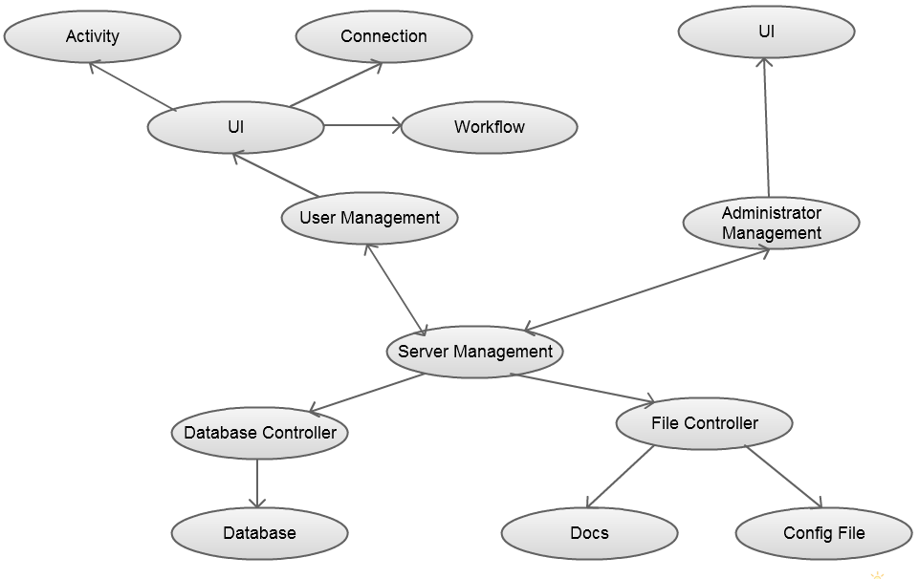
Component Interactions

Slide 13
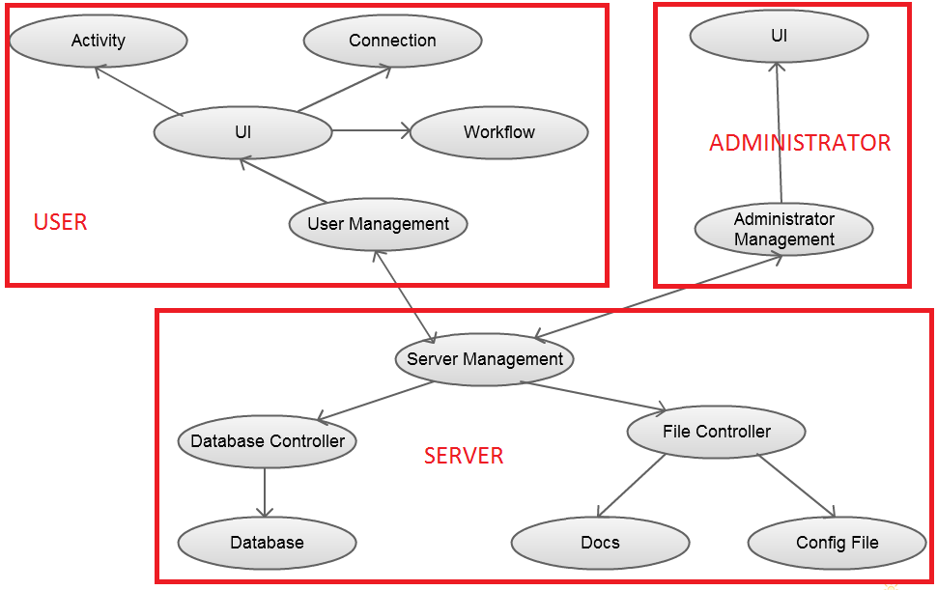
Component Interactions

Slide 14
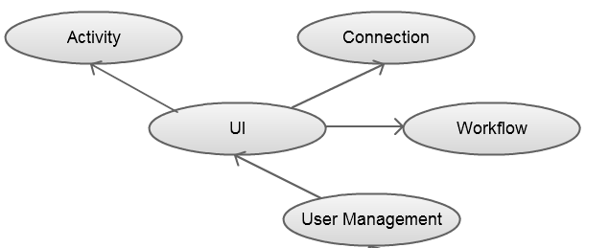
USER
Explanation of the components with their interactions
GUI

Slide 15
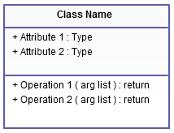
ACTIVITY
Some examples of activity types

Slide 16
CONNECTION
How connection works

Slide 17
WORKFLOW
Created when a new document opened.
Holds all of the activities and connections of the document.
NOT stores graphical items but stores only instances of activities and connections.

Slide 18
UI
Provides human and computer interaction.
User has 3 graphical interfaces.
Login
Select document
Working area

Slide 19
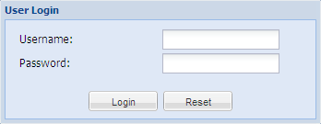
Login
User enters «Username» and «Password» to login the system.

Slide 20
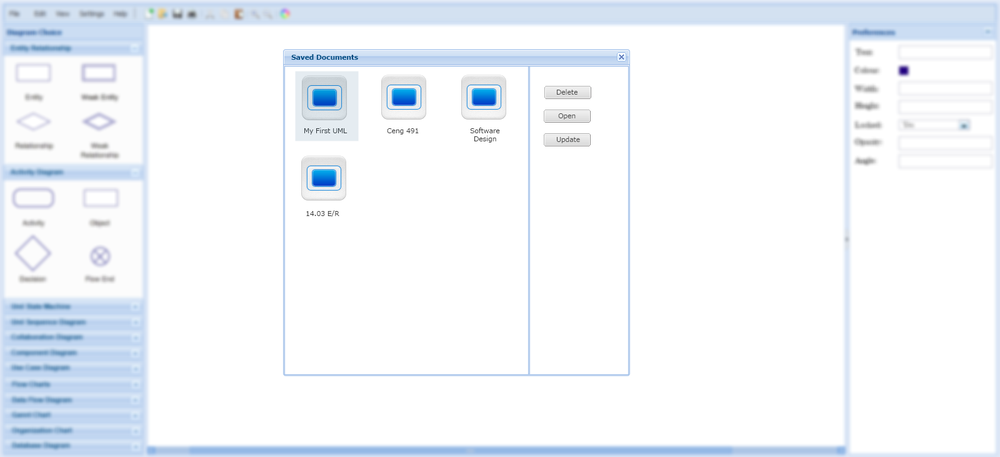
Select Document
User selects saved document to continue to work on it.

Slide 21
Working Area
Main usage area of user.

Slide 22
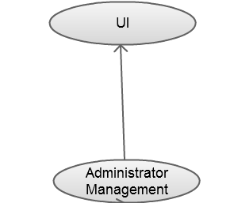
ADMINISTRATOR
Contains two components

Slide 23
ADMINISTRATOR
Contains two components
UI
Administrator login
Administrator screen

Slide 24
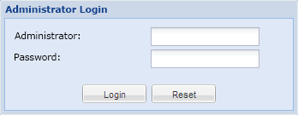
Login
Administrator enters «Administrator» and «Password» to login the system.

Slide 25
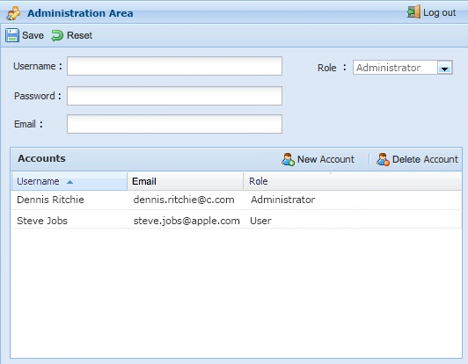
Administrator Screen
Administrator can add or delete a user or an administrator.

Slide 26
SERVER
Contains 6 components.
Database Controller
Database
File Controller
Docs
Config File
Server Management

Slide 27
DATABASE CONTROLLER
Provides access to the database.
Returns the database result set for a given query.
Controls the correctness of the data
- e.g. invalid password.

Slide 28
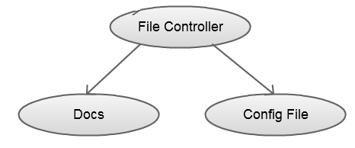
FILE CONTROLLER
Access to:
user saved documents
Config file

Slide 29
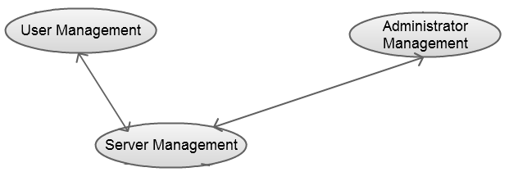
USER, ADMINISTRATOR AND SERVER MANAGEMENT
Provides interfaces to the subsystems to communicate with others.

Slide 30
What Did We Do So Far?
Introduction of Team
Problem Definition
Our Approach
Components of the System
What Did We Do So Far?
What Does the Future Promise?

Slide 31
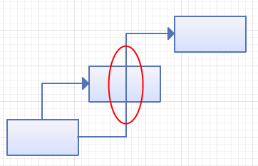
What Did We Do So Far?
Bad Side Research

Slide 32
What Did We Do So Far?
Analysis of System
Efficient System
User Friendliness
System Requirements

Slide 33
What Did We Do So Far?
Analysis of WFs
Needs of Us
Rule Requirements
Customizing

Slide 34
What Did We Do So Far?
Determine the Technologies
Ext-JS
Processing-JS
JSON

Slide 35
What Does the Future Promise?
Introduction of Team
Problem Definition
Our Approach
Components of the System
What Did We Do So Far?
What Does the Future Promise?

Slide 36
What Does the Future Promise?
Creation of the Rules
Interconnection of Technologies
Connection Algorithm
Implementation of Whole System

Slide 37
References
Projects @ Apache Documentation, http://projects.apache.org/docs/index.html
Oryx Configuration Specifications
JSON and XML, http://www.json.org/xml.html
Ext-JS usage, http://docs.sencha.com/ext-js/4-0/
Processing.js references, http://processingjs.org/reference
XAML explanations, http://msdn.microsoft.com/en-us/library/ms752059.aspx

Slide 38
Thank You Any Question?

